Slide 1

Lectures, Slides, & Q&A
Lecture slides with audio:
Activity flow
<https://github.com/braddelong/public-files/blob/master/econ-115-module-0-lecture-1-activities-%23tceh.pptx>
The educational process
<https://github.com/braddelong/public-files/blob/master/econ-115-module-0-lecture-2-education-process-%23tceh.pptx>
Dasgupta’s take on economics
<https://github.com/braddelong/public-files/blob/master/econ-115-module-0-lecture-3-dasguptas-takes-%23tceh.pptx>
Logistics
<https://github.com/braddelong/public-files/blob/master/econ-115-module-0-lecture-4-logistics-%23tceh.pptx>
Link
Link

Slide 2
Lecture: Activity Flow for a Typical Module
watch:
introductory
video
read:
prefatory
reading notes
read:
assigned
readings
discuss:
(asynchronously)
readings
participate:
60 min zoom
q&a session
(post-session
quiz)
(asynchronously)
reflect & discuss
the module
do:
jupyter notebook
problem set
watch & listen:
slides with
audio
section
breakout:
45 min 8 person
zoom section
discussion (15
min with GSI)
submit
section google
doc (&, if chosen
present
talk: for 15 min
about the course
with someone
not in your section
(email zoom meeting
id to instructors)
provide
feedback
to teachers
https://github.com/braddelong/public-files/blob/master/econ-115-module-0-lecture-1-activities-%23tceh.pptx
4:30 audio; 7:45 in this slide group
Notes:
Thus we plan for the activity flow for a typical course module to be something like this:
First: watch a very short introductory video. I am, truth be told, not enamored of introductory videos. But the research indicates that I am wrong. Human faces are very arresting. Hearing my voice and looking at my face—even on a flat screen—creates a human contact and makes me much more real to you. Your brain is then much more likely to figure out that what I say may well be important, and thus take the material from this course and make permanent connections rather than dumping it. That is the only way to, as the Greek historian Thoukydides writing in the early -300s put it, make what he or I have to teach into “a treasure for all time”.
After the short introductory video, go and read the prefatory reading notes: they tell you what to look for in the assigned articles and book chapters, so that you do not start out as a blank, passive slate attempting to absorb words but rather begin to ask questions—and expect answers—from moment one.
And then read the assigned readings, and read them with intent.
After reading the assigned readings, go to the readings comprehension quiz. It is very short. Its purpose is not to test the things we want you to get out of the reading. Its purpose is, rather, so that you can judge whether you actually absorbed much from the readings at all.
If you don’t ace the quiz, go back and read the assigned readings again—this time, with more intent, and more internal dialogue.
Doing the reading is to be followed by participating in the (asynchronous, bCourses discussion thread) class-wide readings discussion. Your first contribution can be to answer one of the questions I set out to start the ball rolling. Your first contribution can be to ask a substantive question about the readings that puzzles you. Your second contribution—and your first contribution too, if you like—should be a substantial response to something that one of your fellow students says in the discussion threads. And then, if your contribution called forth substantial responses, you should at least acknowledge them.
Following this asynchronous readings discussion, I have my say. That is in fact what I am doing here: powerpoint slides with attached audio, of which I promise that no more than 40 minutes of audio a week will be required—and hopefully I will get better at compression.
Reading and listening to my slide-based audio lectures will then be followed by a 60 minute zoom q&a session, where I will answer your questions about the readings, the lectures, and the discussions so far—and I will feel free to answer questions none of you have asked if I think that it is important for you to hear my answers. The zoom q&a sessions will be saved and posted, so if you miss one you can listen to it afterwards. But I do recommend “attending” live: live has a different feel, and synchronous has its place.
The zoom q&a session will be followed by your doing the weekly problem set in a framework called the jupyter notebook. More on that will follow—in fact, more on that will follow in the first jupyter notebook problem set. Its purpose is to get you acclimated to and familiar with this system.
After the problem set, we will have three more activities in the module:
We will divide you into not 25-person sections but 8-person breakout groups, and each will have a 30 minute synchronous zoom discussion with themselves, a GSI, me the professor, or more than one of us.
2. We will have another asynchronous bCourses discussion thread, this time focused not on the readings per se but on the module as a whole. As before, your first contribution can be to answer one of the questions I set out to start the ball rolling. Your first contribution can be to ask a substantive question about the readings that puzzles you. Your second contribution—and your first contribution too, if you like—should be a substantial response to something that one of your fellow students says in the discussion threads. And then, if your contribution called forth substantial responses, you should at least acknowledge them.
3. We will require you to provide feedback to us as to how the module went for you.
And then we instructors have our zoom and our email office hours as well…
Complex? Yes. Why? Because we do not have all of the face-to-face, running into fellow students in the cafeteria, complaining on social media about the problem set (actually, I hope that we will still have that), and other activities that in the meatspace version of the course promote the active learning that is the core of the university’s value added.

Slide 3
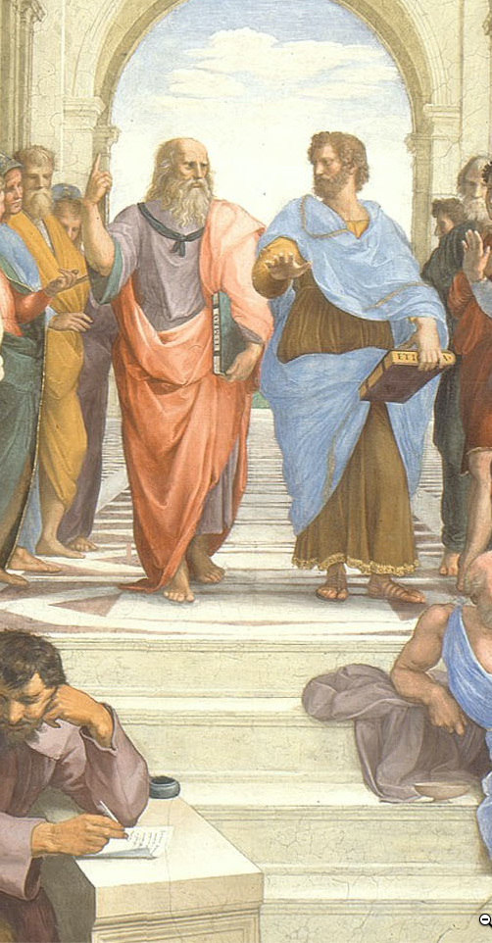

Timings: For Each Module
Aspirations for the weekly timings of the pieces of this course:
All times P[D|S]T…
0 hr: Fr 17:00: freeze all online teaching materials for the module.
Fr 17:00-Su 23:59: students do readings, discuss (asynchronously) readings (with instructors chiming in on the threads); closes at 54 hr.
Mo 00:00-Tu 15:00: students watch & listen to slides-with-audio-lectures.
72 hr: Tu 15:30: zoom q&a session
Tu 17:00-Fr 17:00: students discuss (asynchronously) the module; closes at 168 hr.
We times various: students participate in 20 min 8 person breakout zoom section sessions
We 17:00-Su 23:59: students do jupyter notebook problem set; closes at 199 hr;
Th 15:30: I will try to hold LeConte 4 for (socially-distanced) in-person office hours on the current module; 142.5 hr
Fr: students chosen to present the results from their 8 person breakout sessions give their mini talks
Fr 17:00-Su 23:59: students provide feedback to instructors; closes at 199 hr.
Mo 00:00-Tu 23:59: instructors grade & assess discussion threads, zoom participation, and jupyter notebooks; closes at 271 hr.
Next Fr 12:00-23:59: students review module
Four weeks later Fr 12:00-23:59: students re-review module
Question: Where in this staggered process are things likely to go wrong?
1:00 audio
Notes:
We have a complicated proposed schedule for the various activities—that are twelve in number—that we think will make up the typical module-week. But we reserve the right to make on-the-fly adjustments over the course of the semester. We want to do what works as far as education is concerned. We want to drop what isn’t working. We figure that we have a right to ten and only ten hours of your attention and effort each week. And we want to use those ten hours a week that you are going to give us well.
One more thing to note: we are, each week, going to also look back—review briefly what we did last week, and review in greater depth what we did four weeks ago. Plus there will be the end-of-semester review process. Reminding your brain that, yes, this is important for you to remember and make new connections mentally even if you have not seen it for a while—that kind of structured repetition is very important if your learning is to be more than evanescent.
And I want you to—immediately—email to us where you think something is likely to go wrong with this chain of activities, as far as its assisting your learning is concerned. And we want to be emailed as soon as something does go wrong.

Slide 4
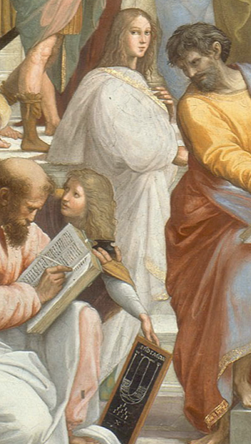
Timings: For the Semester
Notes on the timing of the semester:
First as-class-begins module online materials frozen Fr Aug 21
As-class-begins (optional, recorded) zoom q&a session Tu Aug 25
First required class zoom sessions We Aug 26
Last class day: Fr Dec 4—15 full weeks
RRR week: Fr Dec 4-Fr Dec 11
Final papers due: Fr Dec 18
Question: What else should we be asking people to do, in addition to weekly participation in the threaded discussions, weekly problem sets, & a final paper?
1:15 audio
Notes:
For the semester as a whole, you can begin the first “As Class Begins…” module on Fr Aug 25: we commit to freezing the materials in their final state then. The first of the required (to listen to; not necessarily to attend live—people’s schedules are going to get very complicated very quickly) zoom q&a session will be Tu Aug 25 15:30 PDT; zoom URL: TBA. The last class day will be Fr Dec 4. That gives us 15 full weeks—15 full modules. Plus then there will be our RRR week review. Plus then there will be our final paper.
Now here is a question: Where should we be working you harder? What else should we be asking people to do—in addition to weekly participation in the threaded discussions, weekly problem sets, & a final paper—to make this semester educationally worthwhile for you? Answers and suggestions in email to delong@econ.berkeley.edu please, with “Econ 115 Extra” as the subject line…

Slide 5
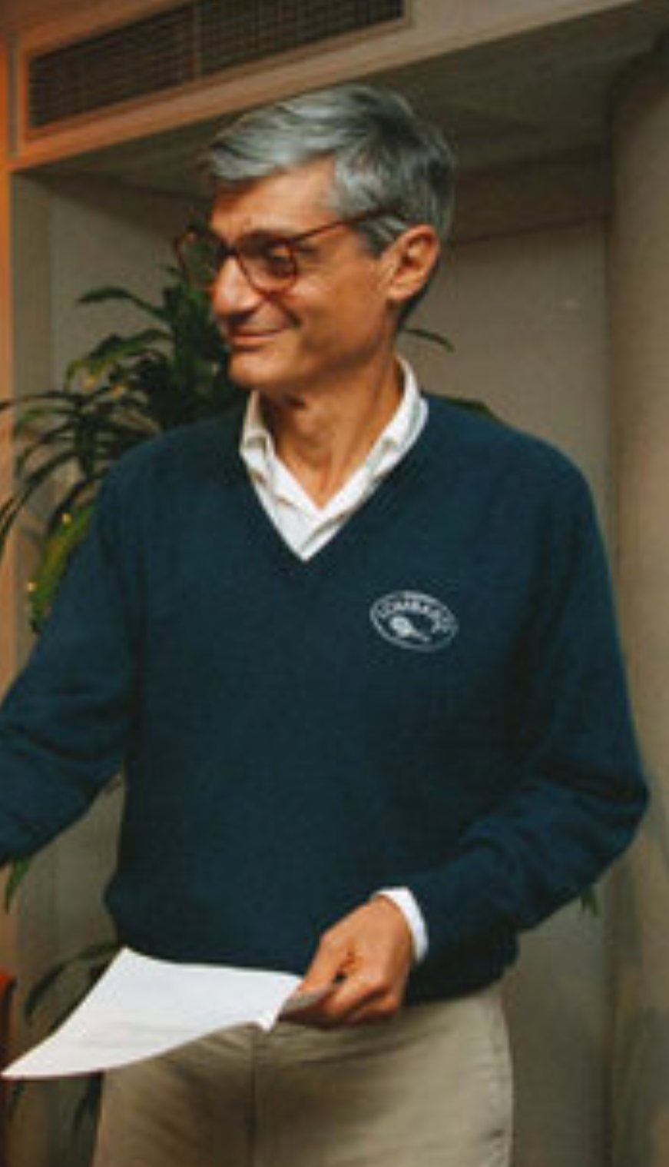
Bob Rubin’s Question
Something I have always found very useful:
Ever since I first heard it back in 1993:
What, at the end of the semester, will we wish we had done today?
Proposed answers:
I will need to hear three at the start of the zoom q&a session…
1:00 audio
Notes:
And one more thing. More than 25 years ago I learned how useful it is to ask Bob Rubin’s Question—I hope you can hear the capital “Q” in question, because it is very important—named after the former Treasury Secretary, NEC Director, and Goldman-Sachs co-head. It is very useful to ask. It is this: What, at the end of the semester, will we wish we had done today?
I will need to hear three proposed answers, at least, at the start of the zoom q&a session. For if you put yourself in your future shoes and look back at what was left undone with regret, and then if you take action, you have the greatest chance of avoiding the situations that you would later regret by taking preemptive action.
I very much want to know now what my regrets might be come December, so I can take action immediately, and so avoid them.
Please help.

Slide 6

Grading
Haas:
Mean elective grade: about 3.5
That seems reasonable: B+/A-
Grading:
Quizes: 0
Discussion threads: 30 x 2 = 60 (0, 1, 2, 3)
Problem sets: 15 x 4 = 60 (0, 1, 2, 4, 5)
Zoom breakout & other participation: 20
Final paper: 60
Points to letter grades:
The way it works is this:
We form our holistic assessment of the degree of effort and accomplishment of the class as a whole,
largely but not exclusively based on the scores people receive on assignments.
That assessment then sets the grade distribution.
We then take the assignment scores, adjust them for notable participation-based assistance in helping others learn, and rank all of you students.
By effort & achievement.
Thus there is not a strict curve:
someone else doing better does not lower your grade.
In fact, it is the opposite—your helping someone else do better raises the average grade and, to the extent that we notice, directly raises yours as well.
But there is also not a rigid set of numerical cutoffs you will be able to count on
Oral exams for edge cases…
UNWRITTEN
Notes:
As to the logistics of this course… They are standard: the syllabus and course policies are in their usual bCourses place; our course number for bCourses is 1493152. You are responsible for reading and knowing the syllabus and course policies.
The principal required reading for the course is the draft of my 20th century economic history book, which I am distributing to you.
That is not the only required book, however. We require you—as class begins—to read Partha Dasgupta’s Economics: A Very Short Introduction as a warmup exercise: it is not a substitute for but rather a complement to Econ 1, and it is meant to remind you of economics as a discipline and get your thoughts moving as to what a history course like this that is an economic history course is likely both to see clearly and not see at all as we look at world history in the 20th century.
We require you—as class begins—to read Robert Allen’s Global Economic History: A Very Short Introduction as a cooldown exercise and as a review. Allen has a somewhat different take on the world economy in the 20th century than I do. Reading him will: (a) provide a critique of my interpretation that you may find useful, (b) remind you of my interpretation, especially where it differs from his, and so aid in active learning, and (c) possibly strike sparks for questions you might investigate as you go about researching for your final papers.
In between, we have Barry Eichengreen (2008): Globalizing Capital: A Short History of the World Monetary System, which we will read throughout the course. The international monetary system is the nervous system of the world economy. Its functions and dysfunctions are key. Barry provides a lot more background into how it functioned in different eras and thus how it fed into the rest of world economic history than I do. In between, we also have Robert Skidelsky (2010): Keynes: A Very Short Introduction. It is said that the history of the fall of the Roman Republic in the -100s is, given our source limitations, essentially the biography of the Roman consul and politician Marcus Tullius Cicero. A huge chunk of 20th century global economic history is the biography of John Maynard Keynes and his ideas. And Skidelsky is a brilliant writer: truly a pleasure to read or so I find him.
Plus we will assign a number of articles—the first of which, Andy Matuschak: Why Books Don’t Work, you should have already read before you got to this lecture.
A note on grading. We will bump up the grades of people whose contributions to synchronous discussions make us think that they got the shaft in the formal point-attribution grading process—that is what the 20 “participation” points are. Quizzes are ungraded: they are supposed to be low stakes exercises. Otherwise, we will split points between asynchronous web discussions, problem sets, and the final paper 1/3-1/3/-1/3.
Contributions to each of the 30 discussion threads will be graded on a 0-2 scale: 0 means that you did not complete the assignment before it closed; 1 means that in our view you simply phoned in your contribution, and did not make an effort; 2 means that you attempted to make a serious contribution to the discussion; 3 we reserve for someone whose contribution genuinely taught us something.
The 15 problem sets will be graded on a 0-4 scale. 0 means that no assignment was submitted or that it was submitted more than 48 hrs after the assignment closed; 1 means that the assignment was submitted up to 48 hrs late; 2 means that the assignment was phoned in, with major components not seriously attempted; 3 means that you attempted all the major pieces but did not successfully complete some important aspects; 4 means that you successfully completed the problem set; 5 means that your problem set was sufficiently ingenious and excellent that it taught us, the instructors, something.

